Slide 1



RESUMES & JOBS
Rick Scott Governor
Barbara Palmer
APD Director
Notes:
Good morning to all of you. You are currently attending the wonderful and exciting two-day Introduction to Social Security Work Incentives training. The training is hosted by Agency for Persons with Disabilities. We are excited that you’re taking the class. You will have an opportunity to learn about social security work incentives and how they can be instrumental in helping people maintain or keep their benefits.

Slide 2

Katrina Washington
Agency for Persons with Disabilities
Operations Review Specialist
Office: 850-595-8329
Cell: 850-556-5859
Email: Katrina.Washington@apdcares.org
Presenter
Notes:
My name is _______________ and I am a(n) _______________ in the ___________ Region. I’ve been employed with APD for _______ years. My background is in ____________. I enjoy working with people and it is an absolute pleasure to work with you today.

Slide 3

MISSION STATEMENT
The agency supports persons with developmental disabilities in living, learning, and working in their communities.

Slide 4

Determination
A dream doesn't become reality through magic; it takes sweat, determination and hard work.
- Colin Powell

Slide 5

Competitive Employment
Refers to jobs held by people with disabilities in workplace settings where the majority of persons employed are not persons with disabilities.
Individuals with disabilities earn wages consistent with wages paid workers without disabilities in the community performing the same or similar work
Earn at least minimum wage and are paid directly by the employer.
-Department of Labor

Slide 6

Integrated Employment
The jobseeker with a disability works in an environment with coworkers that don’t have a disability.

Slide 7
Do You Qualify for the Job?
Take the time to read through the job requirements before applying for the position.
1
Inquire to the human resource manager or the recruiter with any questions.
2
Be sure to only apply to positions for which you qualify.
3

Slide 8

Employment Concerns
What do I want to do?
What is the rate of pay? Is it minimum wage or higher?
What kind of co-workers will I have?
Do I need supports to help me on the job?
Will I have transportation to and from work?
Is there a high turnover rate?
Will I have to work on weekends?

Slide 9

The Job Interview
A job interview opens doors for employment.
Know the workplace dress code of the company that’s offering the interview.

Slide 10

What Is a Resume
A one page summary of your skills, education, and experience.

Slide 11

First Impressions Matters the Most
The first step is to get your resume noticed by the recruiter or employer.
Your resume is the first contact you will make with employers.
The first impression could make you or destroy your chances of getting a job.

Slide 12


Social Media Can Impact the Hiring Process
Your social media pages say a lot about who you are and what you represent.
Employers have more access to you and the world due to social media.
They are able to remove candidates from the hiring pool by viewing individuals Facebook, Twitter, LinkedIn, and Instagram pages.
Don’t post things that can cause a no-hire.
Negative comments about past employers can send a red flag to the employer about your integrity.
Think before you post.

Slide 13
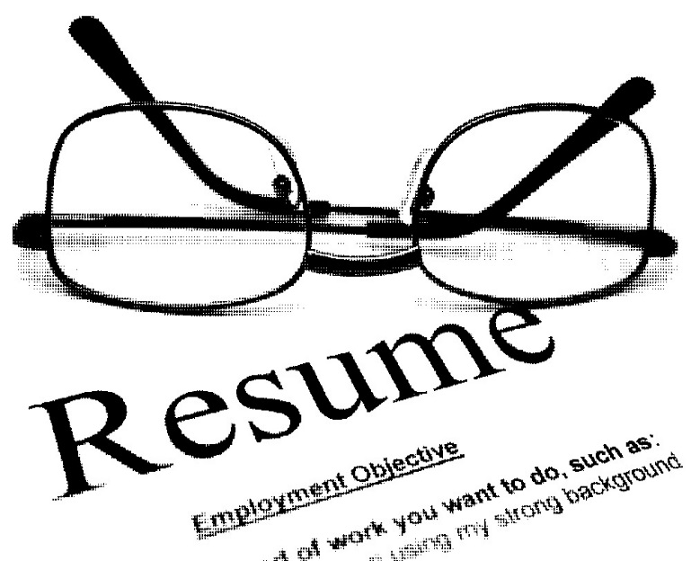
Preparing Resumes
Target your resume to the job description.
Review the task of the job that you’re seeking.
First impressions are important.

Slide 14

Avoid Resume Pitfalls
Typos and grammatical errors
Lack of specifics.
Never changing the resume and using the same resume for all positions with different position descriptions.
Incorrect contact information.

Slide 15

Highlighting Duties Instead of Accomplishments
List the following:
Recorded weekly meeting minutes and compiled them in a Microsoft Word-based file for future organizational reference.
Developed three daily activities for preschool-age children and prepared them for a 10 minute holiday program performance
Reorganized 10 years worth of unwieldy files, making them easily accessible to department members.
Avoid the following:
Attended group meetings and recorded minutes
Worked with children in a daycare setting
Updated department files
www.monster.com

Slide 16

Did You Know?
Human Resource Managers and recruiting staff will spend 3 to 6 seconds reviewing resumes?
90% of employers filter resumes and job applications through an applicant tracking system (ATS)before the resumes are read.
If qualifications aren’t listed, the employer will discard the resume.

Slide 17

Resumes
Accentuate the Positive
Deflect or Downplay the Negative
Notes:
You can accentuate the positive by listing the candidate’s accomplishments and awards. Focus on your skills, your strengths and experience that will be used for the job sought not for the previous job held. It wouldn’t be a good idea to list your experiences on a certificate in food safety from a restaurant if you are applying for a stocker position in retail. Be sure to match your experience with the position your applying for. You would focus on customer service in both positions.
A company states it’s easy to places resumes in two piles: The qualified pile and the unqualified. pile The corporation was able to “weed out” applicants due to applicant’s resumes failing to match the position description of the job. For example, an individual had a Bachelor’s Degree in Psychology. He listed all of his experience in working with people with mental disabilities. However, he applied for a job that entailed crop harvesting experience. The resume failed to list or meet the requirements of the position. Therefore, the college graduate’s resume was discarded and the job seeker wasn’t considered for the position.
Deflect or downplay information that may be construed as negative on your resume. Don’t accentuate job dates if many are less than 3 years in duration.

Slide 18

Four Types of Resumes
  Chronological Resume
  Functional Resume
  Combination Resume also called the “Hybrid Resume”
  Targeted Resume
Notes:
There are four types of resumes that a job seeker can use: chronological resume, functional resume, combination resume and targeted resume. As an Employment Consultant, you will be able to identify the resume that best fits the job seeker you’re serving. In this training, we will focus on chronological and functional resumes.

Slide 19

Chronological Resume
  Work history is listed in chronological order. It starts with your most recent job and it ends with your initial job.
  Most preferred resume by employers because it gives a picture of the job seeker’s most recent employment.
  It covers the job seeker’s last 10 years of employment.
  The job task are attached to each position held.
  It should be utilized if you have a concrete work history with no lapses in employment.
Notes:
The chronological resume is the most preferred resume for employers. It gives them an opportunity to review the job seekers most recent work history and earlier employment in chronological beginning with the most current job. The chronological resume is advantageous for job seekers with a solid work history. This means there are no gaps or lapses in employment. The job seeker has a history of maintaining employment without fluctuations.
Read and review pages 67-71 in the Best Practices Manual to review the 3 main sections of a resume and the overall structure of the chronological resume.

Slide 20

Functional Resume
  A functional resume is different from a chronological resume. It emphasizes your skills and experience. It deemphasizes the date of employment.
  Great to use if the job seeker has employment gaps.
  Best option for a job seeker changing jobs or careers, and a job seeker with little to no work history and short duration of employment.
  Great tool for job seekers with volunteer experience.
Notes:
Functional resumes are beneficial to individuals with employment gaps, little to no work history, fluctuations in employment, and short-term employment. As an employment consultant, you will find that some job seekers have little to no experience but a diverse skill set. How can you create a functional resume? Choose 3 or 4 functions from a position description for which the job seeker has experience and focus on those as headings on the first page.

Slide 21

Combination Resume (Hybrid Resume)
  A combined resume is a combination of a chronological resume and a functional resume.
  The job seeker is able to list details of his or her skills and accomplishments first. The work experience or history is followed after the skills and accomplishments. Information is listed chronologically.
  Work experience will list position titles, company name/locations, and dates of employment.
Notes:
A combined resume focuses on the skills and experience of the job seeker. The work history is listed chronologically after the skills and experience.

Slide 22

Targeted Resume
  A targeted resume entails the job seeker customizing their resume in detail to meet the qualifications of the position they are seeking.
  Note: Targeted resumes can be time-consuming to create. They render the best results because the resume describes the qualifications of the position.
Notes:
Targeted resumes can be advantageous because the information customized on the resume to the qualifications of a specific position description. Targeted resumes will need to be tweaked continuously to reflect each position description.

Slide 23

Overview: Basic Rules of All Resumes
Resumes are dynamic and should be formatted so that each resume may be revised in response to the employer’s position description.
Limit the resume to one to two pages at the most (except for some managerial and upper level positions).
Keep your resume current and in good condition.
Always bring additional copies for your interview.
The heading on your resume becomes your letterhead for all communications.
Notes:
Employers have stated that job seekers tend to arrive at interviews without their resumes. Never assume that the employer has copies of your resume. Even though the job seeker may have uploaded the resume online, it is important to bring several resumes to an interview. Informative, brief resumes are affective.
Your resume is a gateway for employers to see your qualifications prior to meeting with you. Proof read your resume. Review your employment dates. Accurate and truthful information should be listed on the resume. You don’t have to ‘fudge” your information to attain a job. Listing jobs or duties that you didn’t do can be harmful to future employment.

Slide 24

What Happens After the Resume is Completed?
If you are a job-seeker, networking and sharing your resume with employers should be your full-time job.
Many jobs are filled through networking.
Don’t rule out your personal contacts. Your personal contacts can be connected to the right people.

Slide 25

Questions or
Comments?

